Slide 1

Kickstarter Success Predictor
Omar Qusous

Slide 2
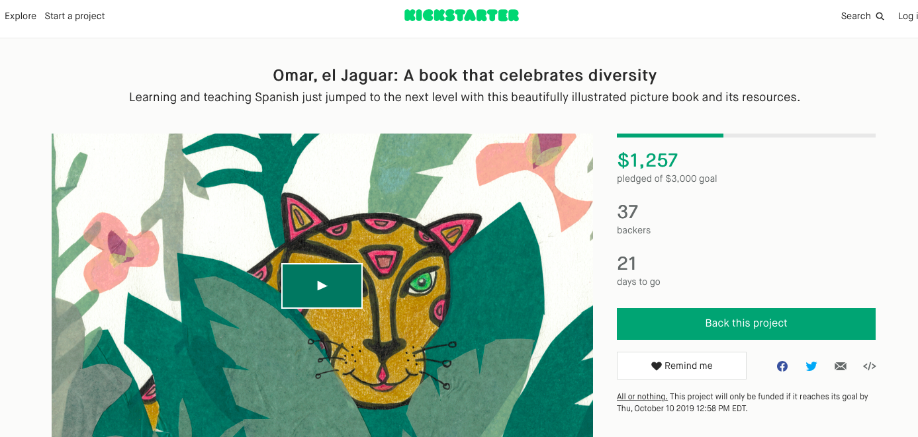
What can you do to increase the project’s chances of success?
Notes:
Awesome ideas like this?

Slide 3
Data Source 1
https://webrobots.io/kickstarter-datasets/
Total of 9338 points. Aim to keep 5000 or more (duplicates, Nans, etc…)

Slide 4
Data Source 2
Key:
All NAN:
Repeated information:
Data leakage:
Not useful (logic):
Feature Selection:
['backers_count', 'blurb', 'category', 'converted_pledged_amount', 'country', 'created_at', 'creator', 'currency', 'currency_symbol', 'currency_trailing_code', 'current_currency', 'deadline', ‘'disable_communication', 'friends', 'fx_rate', 'goal', 'id', 'is_backing', 'is_starrable', 'is_starred', 'launched_at', 'location', 'name', 'permissions', 'photo', 'pledged', 'profile', 'slug', 'source_url', 'spotlight', 'staff_pick', 'state', 'state_changed_at', 'static_usd_rate', 'urls', 'usd_pledged', 'usd_type'])
Final Features:
category: Film, Music, Fashion etc..
location: country and state converted to continents to balance data
created_at: data of starting the campaign
deadline: deadline set for achieving the desired amount of money
name: projects name
staff_pick: projects highlighted on homepage
goal: desired amount of money to succeed
Notes:
After reading the data on Notebook, I started to clean it by:
All NAN: ‘'disable_communication', 'friends'
Repeated information: ‘static_usd_rate', 'blurb'
Data leakage: 'spotlight', ‘baclers’
Not useful (logic): 'photo', 'currency_symbol'
Remainder Category, Continent from which project originates, created and deadline times, staff_pick(homepage highlights) and GOAL!!!!!!!

Slide 5
EDA and Feature Engineering 1
Continuous Data:
Log(df['time_allowed']) and Log(df['goal'])
df['time_allowed'] = df['deadline']-df['created_at'] # in days
outliers = df[(df['time_allowed'] > 5000) & (df['goal'] > 2e6)]
Categorical Data:
Converted to dummies
df[['category', 'staff_pick', 'country']]
Total of 168 columns in X
Notes:
Log time and goal
Dummy the categorical data

Slide 6
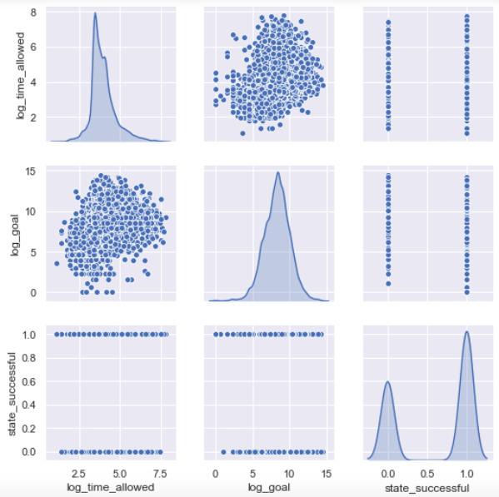
EDA and Feature Engineering 2
Notes:
Pair plots

Slide 7
Target
Target:
‘State’ : successful, failed, suspended, live, cancelled
Eliminated live, cancelled and suspended
‘Binary distribution (1: success, 0: failure)
Notes:
Success or failure. Omitted other states such as cancelled, live and suspended.

Slide 8
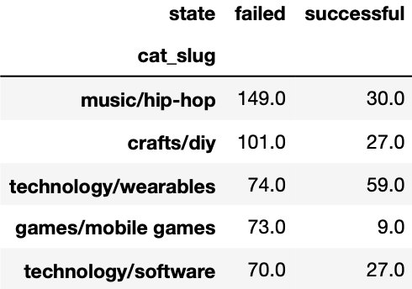
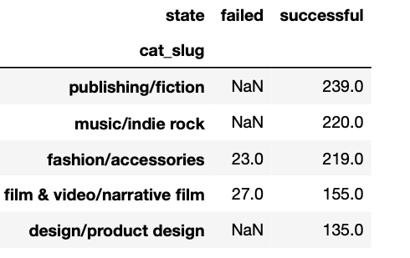
Quick Interesting Stats 1
Most successful and unsuccessful project categories
Notes:
Rock not hiphop

Slide 9
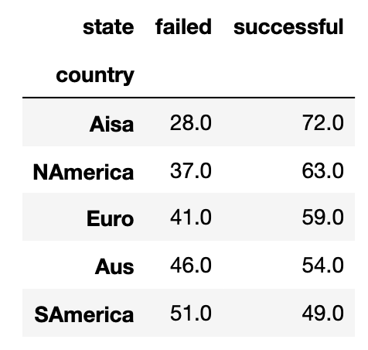
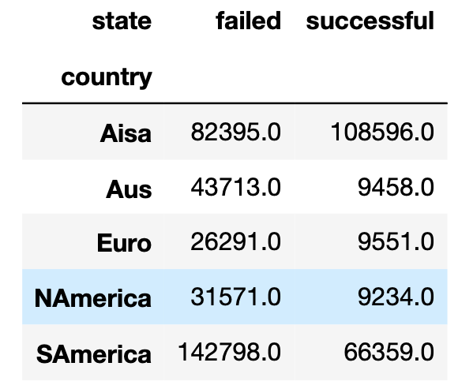
Quick Interesting Stats 2
Percentage Success/Failure by Continent
Average ‘Goal’ for successful and failed projects
Notes:
Aisa better chances of success and on average goal can be set higher
Not fair for mexico as it is the only country in Central america

Slide 10
Models 1
Ran Three Models:
Baseline model of dummyclassifier used which gave 63% accuracy
Random Forest with hyperparameter tuning using iterations and AUC vs Parameter range plots
Logistic Regression with hyperparameter tuning in solver type, C parameter and penalty
XGBoost with and without Gridsearch.
All models were validated first with training data and then tested with the testing data.
Notes:
Vanilla of RF validation showed over training
RF+tuning yielded better results in that respect
LogReg vanilla performed better
LogReg tuned performed the best
XGBoost unexpectedly under performed- want to vary more features on Gridsearch, however, it takes alot of time

Slide 11
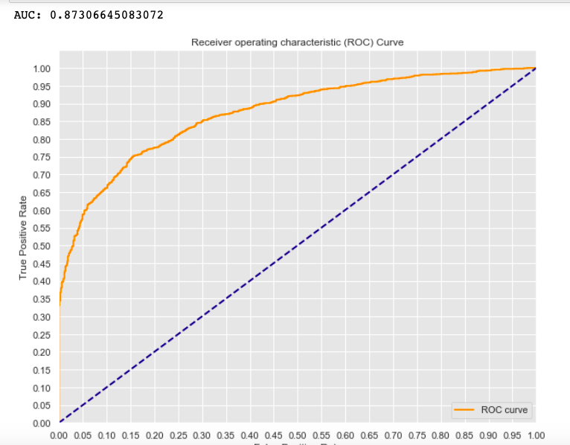
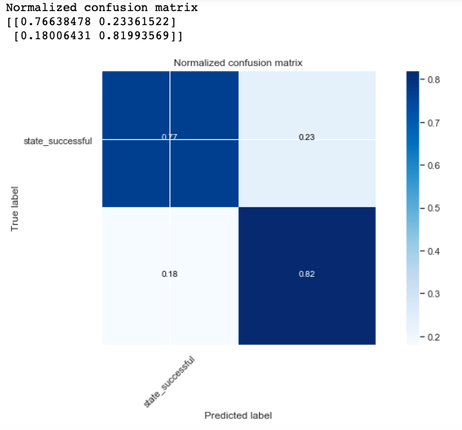
Models 2 - Final Model
Logistic Regression with l1 penalty, bilinear solver gave the best results

Slide 12
Models 3 - Comparisons
Model | Confusion Matrix TN, FP, FN, TN | Accuracy | Reccall | Precision | F1
Random Forest Tuned | [[ 681 265] [ 314 1241]] | 77.2% | 85.9% | 79.5% | 82.6%
LogReg | [[ 712 234] [ 277 1278]] | 79.6% | 82.2% | 84.5% | 83.3%
LogReg Tuned | [[ 725 221] [ 280 1275]] | 80.0% | 82.0% | 85.2% | 83.6%
XGBoost with GridSearch | [[ 593 353] [ 187 1368]] | 78.4% | 88.0% | 79.5% | 83.5%

Slide 13
Models 4 - Improvements
Quantify quality of the project’s presentation through recognising the use of videos, images and rewards.
Monitor updates from project founders and number of backers/amount of pledges for first 10-20 days and quantify it as a feature.
Work on better classifying project categories and make them more uniform

Slide 14
Thank you

